Slide 1


AI-Driven Citizen Support and Complaint Management Using Natural Language Processing Course code – DSA0306 Natural Language Processing
Presented by: T. Kiran Kumar(192472321) Y. Sai Kumar (192425218)
I. Leela Sravan Kumar (192425272)
A. Mohith Krishna (192425199)
K. Varshan (192325089)
Guided by:
Dr. - T. Kumaragurubaran

Slide 2
Introduction
Government agencies receive a large number of public complaints related to roads, water supply, electricity, sanitation, drainage and other civic services.
Traditional complaint handling often involves manual registration, classification, forwarding and follow-up, which can result in delays and inefficient complaint resolution.
Citizens may submit complaints in different languages and writing styles, making it difficult to quickly understand, categorize and prioritize each complaint.
Artificial Intelligence and Natural Language Processing (NLP) can help the system understand citizen complaints and automatically identify their category, priority and responsible department.
The proposed system allows citizens to submit complete complaint details and supporting evidence, while providing a unique complaint ID for tracking.
The system can detect duplicate complaints, route complaints to the appropriate department, monitor status and support escalation when complaints are delayed.
After resolution, citizens can provide feedback, while authorities can use analytics to identify recurring problems, complaint hotspots and service trends.

Slide 3
Objectives
To develop an AI-driven citizen complaint management system using Natural Language Processing for efficient public grievance handling.
To provide a platform for citizens to submit complaints with complete details, location information and supporting evidence.
To understand and process complaints submitted in multiple languages and different writing styles.
To automatically classify complaints and identify the appropriate government department for handling.
To determine the severity and priority of complaints so that critical issues receive faster attention.
To detect duplicate or semantically similar complaints and reduce redundant processing.
To provide complaint tracking, status updates and escalation throughout the resolution process.
To collect citizen feedback and generate analytics to identify recurring problems, complaint trends and department performance

Slide 4
Problem Statement
Existing public complaint management systems largely depend on manual registration, classification and forwarding, which can increase processing time and cause delays in resolving citizen issues.
Citizens submit complaints in different languages and writing styles, making it difficult for authorities to quickly understand the complaint and identify the actual problem.
Duplicate complaints and incorrect department assignment can result in repeated processing, inefficient use of resources and delays in taking appropriate action.
Critical complaints may not receive proper priority based on their severity and urgency, which can delay attention to issues requiring immediate action.
Citizens often have limited access to real-time complaint status information, making it difficult to know whether their complaint has been assigned, processed or resolved.
Complaints that remain unresolved for a long time require continuous monitoring and follow-up, which can be difficult with completely manual processes.

Slide 5
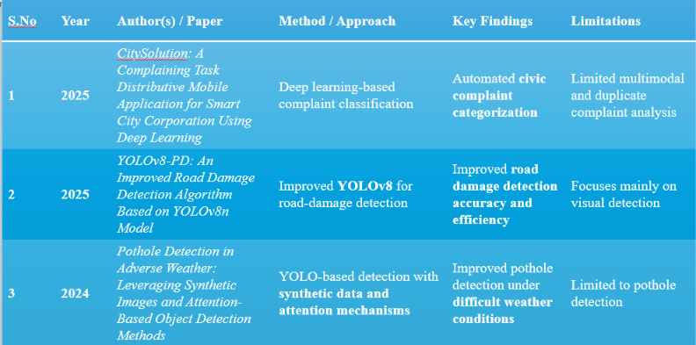
Literature Survey

Slide 6
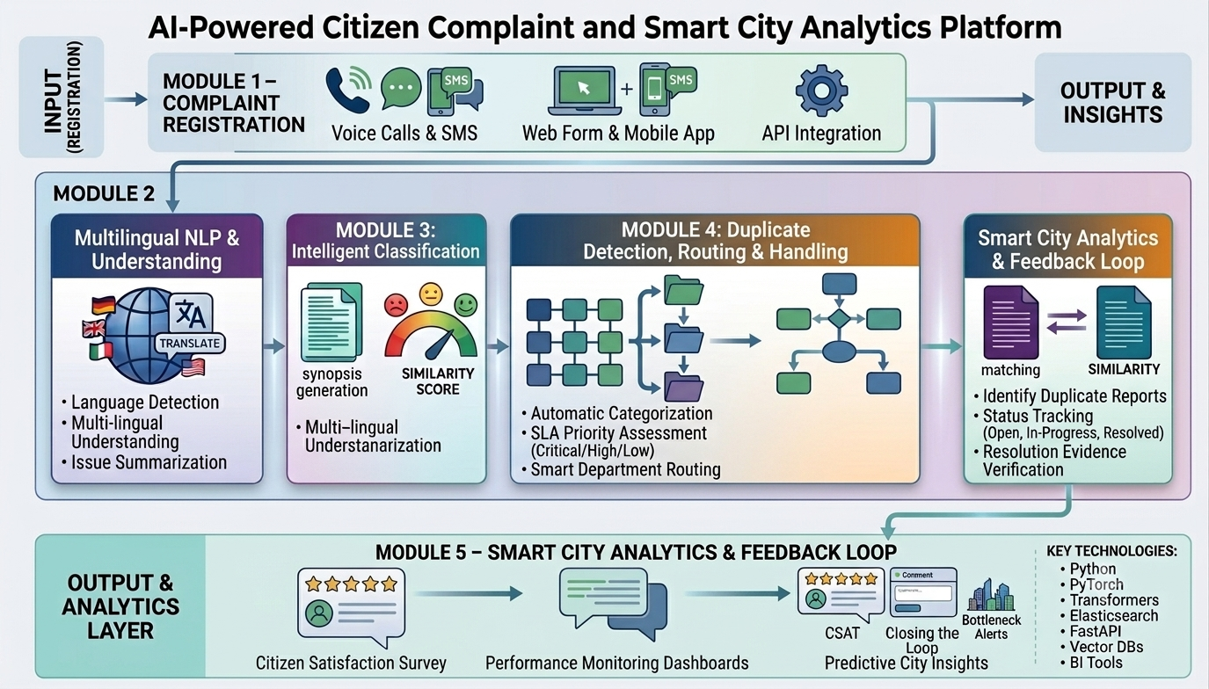
Architecture Diagram

Slide 7
MODULE 1 – CITIZEN COMPLAINT REGISTRATION & DETAIL COLLECTION
Purpose: Provides citizens with a structured platform to submit public complaints with complete information required for processing and resolution.
Working:
The citizen opens the complaint portal and enters the required details.
The citizen describes the public issue in natural language.
Location, contact details and other necessary information are collected.
Images or videos can be attached as supporting evidence.
The system validates the required fields before submission.
A unique complaint ID is generated after successful registration.
The complaint is stored in the database and sent to the NLP processing module.
Uses:
Structured complaint registration.
Complete information collection.
Evidence-based complaint submission.

Slide 8
MODULE 2 – MULTILINGUAL NLP & COMPLAINT UNDERSTANDING
Purpose: Enables the system to understand complaints submitted in different languages and writing styles using Natural Language Processing.
Working:
The citizen submits a complaint in the preferred language.
The system identifies the language of the complaint.
If required, the complaint is translated into a common processing language.
NLP preprocessing removes unnecessary words and text noise.
Important information such as problem, location and issue type is identified.
The processed complaint is passed to the classification and priority module.
Uses:
Language identification.
Machine translation.
Multilingual complaint processing.

Slide 9
MODULE 3 – INTELLIGENT CLASSIFICATION, PRIORITY & SMART ROUTING
Purpose: Automatically identifies the complaint category, determines its priority and forwards it to the appropriate government department.
Working:
NLP model analyzes the complaint and identifies its category.
Complaint content and severity indicators are used to determine priority.
System assigns a priority level such as Low, Medium, High or Critical.
Complaint is automatically routed to the appropriate government department.
Example:
Complaint: "A live electrical wire has fallen on the road near a school."
Category: Electricity Priority: Critical Department: Electricity Department.

Slide 10
MODULE 4 – DUPLICATE DETECTION, TRACKING & RESOLUTION MANAGEMENT
Purpose: Identifies duplicate complaints and manages the complaint from departmental assignment until final resolution.
Working:
New complaints are compared with existing complaints using semantic similarity.
Duplicate or related complaints are identified and linked when appropriate.
Citizen tracks the complaint using its unique ID while departments update its status.
Status can progress through Submitted → Assigned → In Progress → Resolved → Closed.
Department resolves the complaint, or it is escalated to a higher authority if delayed.
Uses:
Semantic duplicate detection.
Complaint status tracking.
Department-level resolution management.

Slide 11


MODULE 5 – FEEDBACK, MONITORING & SMART CITY ANALYTICS
Purpose: Collects citizen feedback after resolution and provides authorities with analytical information about complaint trends and public-service performance.
Working:
Citizen receives a notification after the complaint is resolved and provides feedback.
System records satisfaction ratings and comments about the resolution.
Complaint data is analyzed based on category, location, time and status.
Authorities can monitor pending, resolved, high-priority and escalated complaints.
Dashboard identifies trends, hotspots, recurring problems and department performance.
After resolution, the citizen receives a notification.
Uses:
Citizen feedback collection.
Complaint monitoring.
Department performance analysis.

Slide 12
Conclusion
The proposed system uses Artificial Intelligence and Natural Language Processing to make citizen complaint management faster and more efficient.
It can understand, classify, translate, and process complaints submitted in natural language.
Automated complaint categorization and routing can reduce manual effort and response delays.
Multilingual support improves accessibility and inclusiveness for citizens from different linguistic backgrounds.
Complaint analysis can help authorities identify common problems and service gaps.
Overall, the system provides a smart, scalable, and citizen-friendly approach to modern complaint management.
With further development, AI-based citizen support can contribute to faster resolution, improved transparency, and better public services.

Slide 13
Future Scope
AI-Powered Classification: Improve automatic categorization and prioritization of complaints using advanced NLP and machine learning.
Sentiment Analysis: Detect urgency, frustration, and public sentiment to prioritize critical complaints.
Smart Routing: Automatically forward complaints to the appropriate department or authority.
Real-Time Monitoring: Provide dashboards for tracking complaint status, response time, and resolution rates.
Predictive Analytics: Identify recurring issues and predict potential problems before they become major complaints.
Chatbot Integration: Provide 24/7 AI-based assistance for complaint registration, status tracking, and FAQs.
Mobile and Web Integration: Develop accessible platforms for citizens to interact with government services easily.

Slide 14
THANK YOU

